Slide 1
Networking and the internet
Lesson 5: Connecting to the internet

Slide 2
Objectives
In this lesson, you will learn:
the features of wired network connections
how Wi-Fi connections work
different methods of wirelessly connecting to the internet
about the security risks of using public hotspots
how to decide which method of connecting to the internet to use.

Slide 3
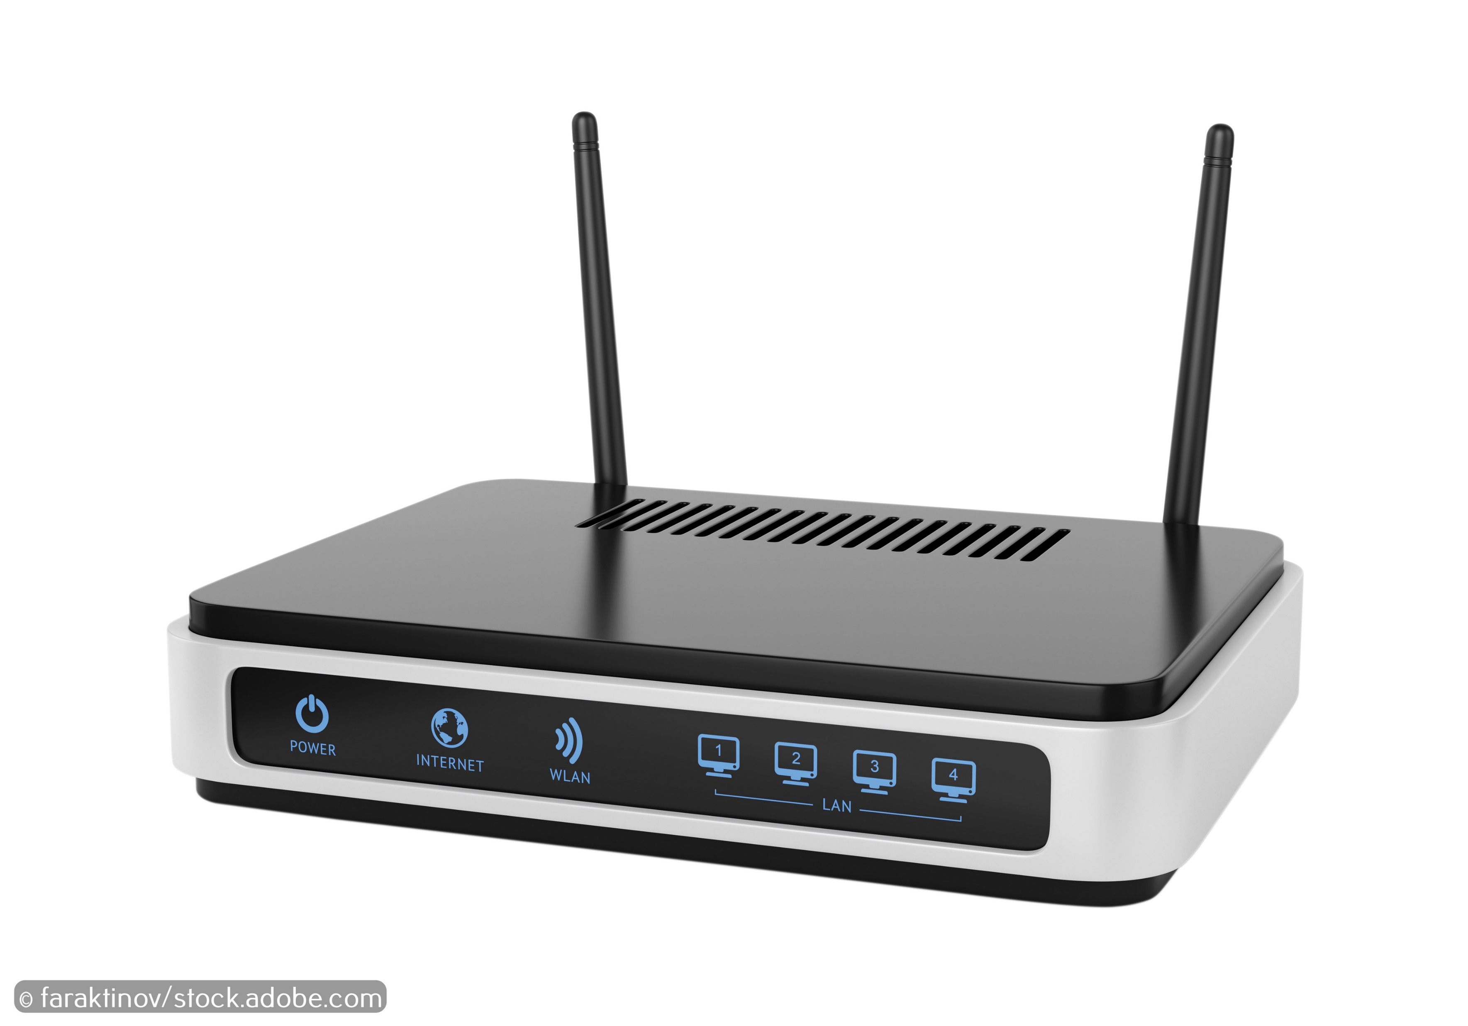
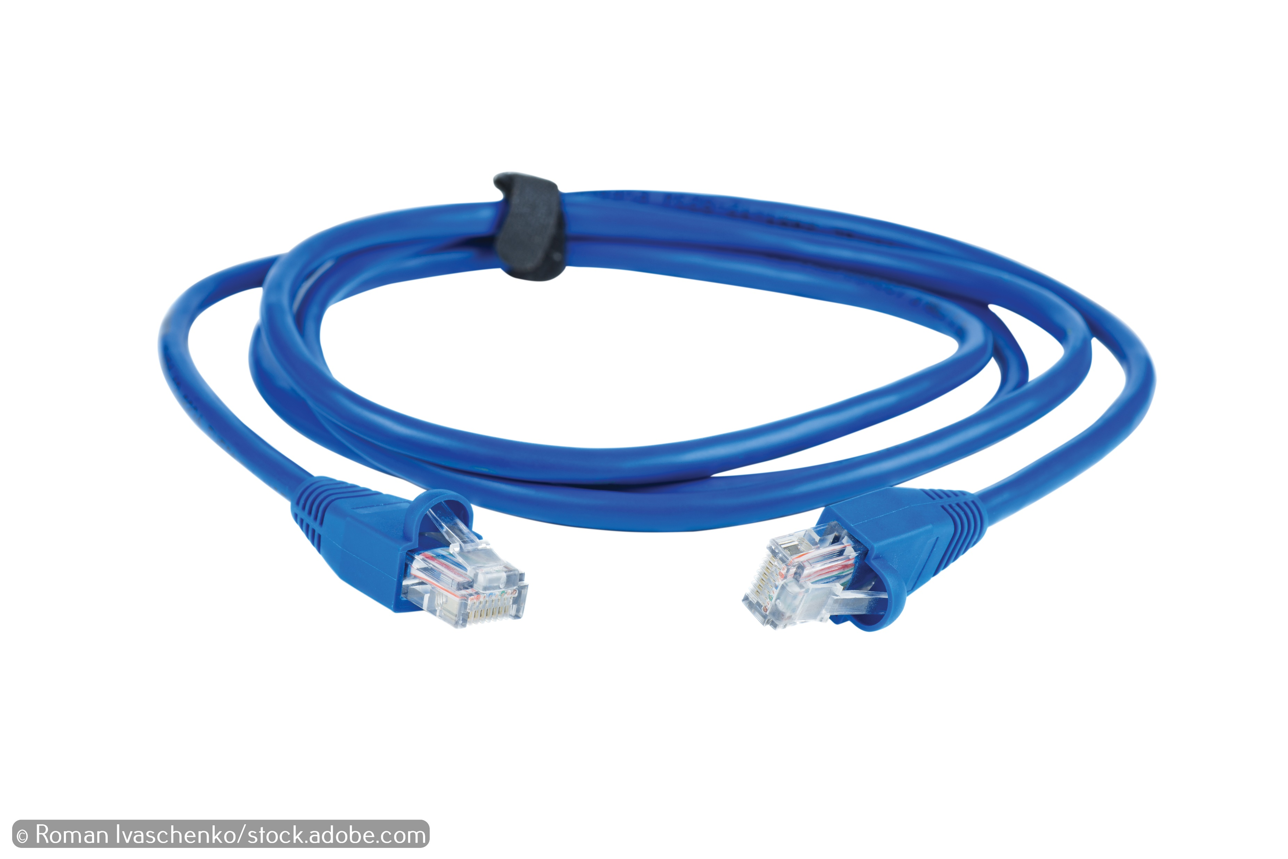
Network connections
There are two main ways to connect to a network.
Wired: Ethernet cables Offices and classrooms usually use a cabled network connection. | Wireless: Wi-Fi People usually use a wireless network connection in their homes.

Slide 4
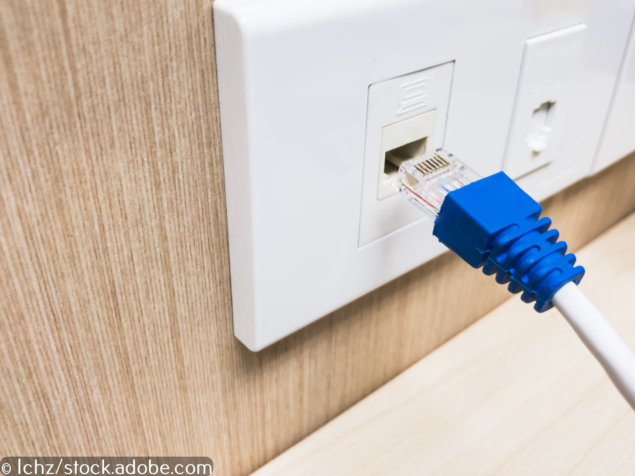
Wired connections
Advantages:
Stable
Reliable
Fast
Disadvantages:
You need to buy cabling.
You need to install cabling
You cannot move around and stay connected to the network.

Slide 5
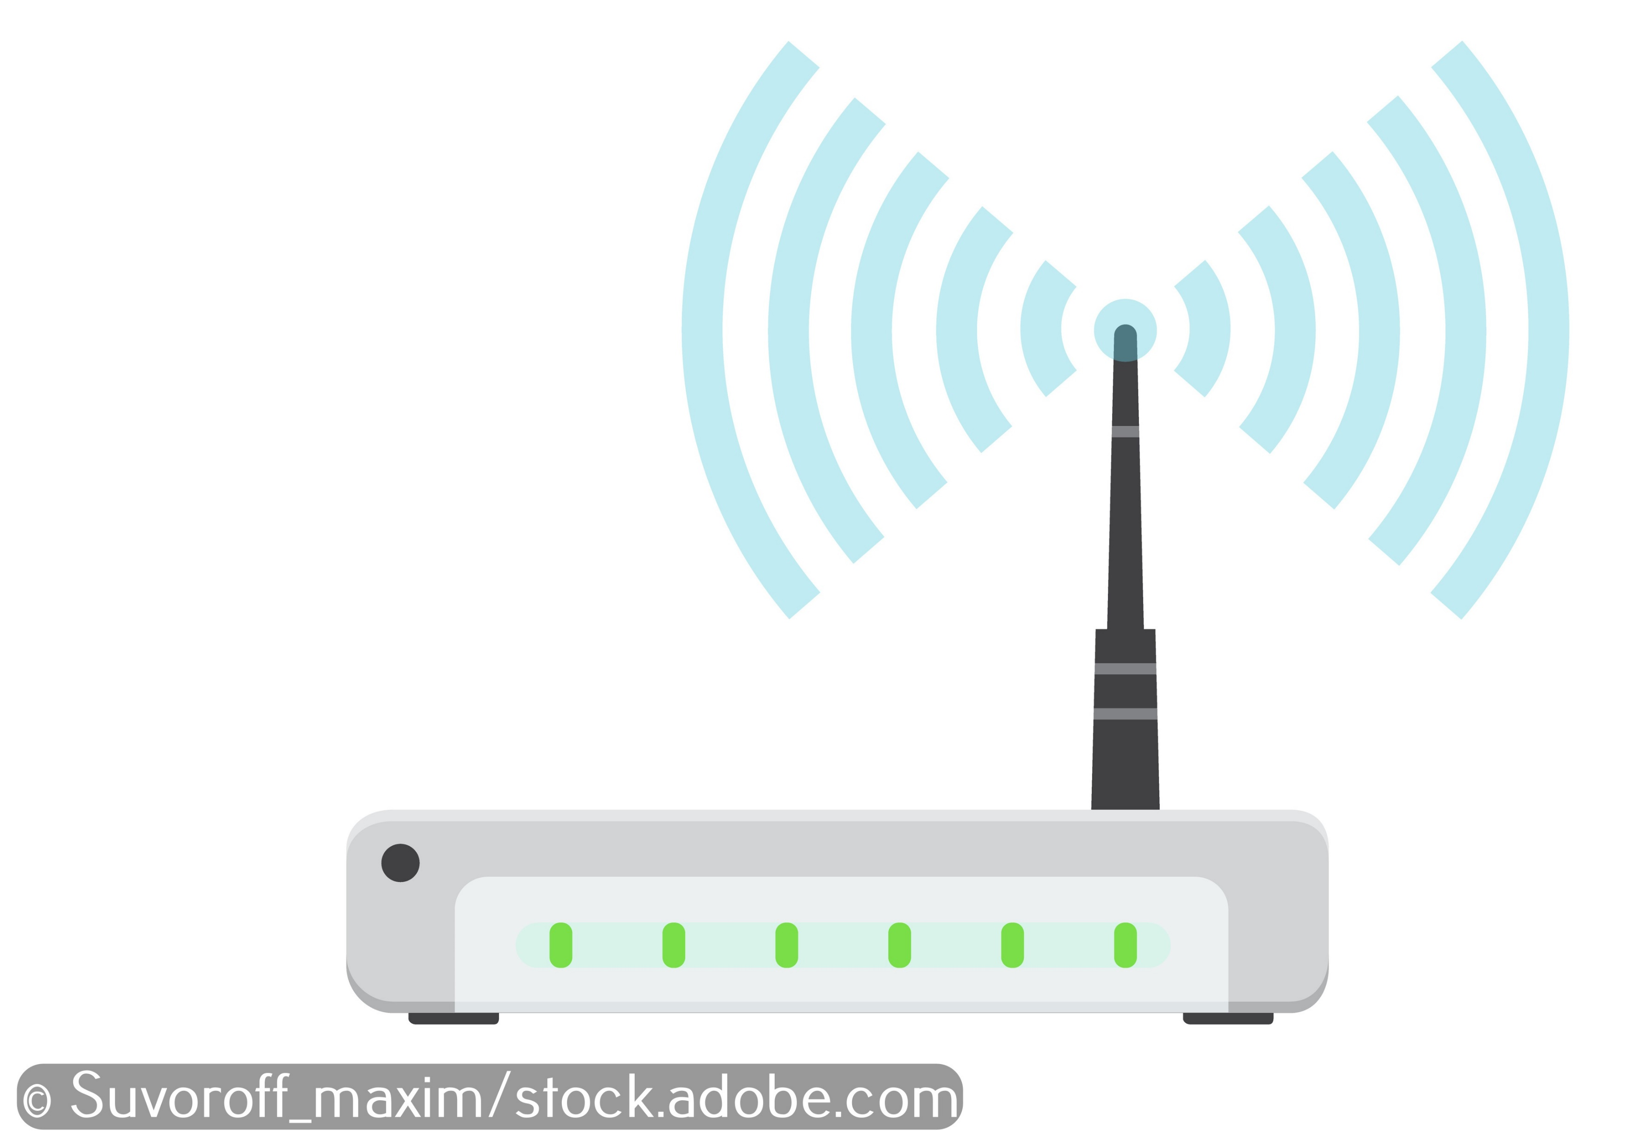
Wi-Fi
Wi-Fi uses radio waves transmitted to and from a wireless access point to send data through the air.
Any device that is connected to the network and in range of the wireless access point can send and receive data using Wi-Fi.
You can turn a wired network into a wireless network by adding a wireless access point.

Slide 6
Problems with Wi-Fi
All devices in range can pick up a Wi-Fi signal. This means anyone nearby can eavesdrop on the data communicated over a Wi-Fi network.
This is why you must make sure your home Wi-Fi is encrypted. Encrypted data can still be intercepted, but the eavesdropper is unlikely to understand it.
This is also why you must password-protect your home Wi-Fi network, so that only people with the password can gain access to the network.

Slide 7
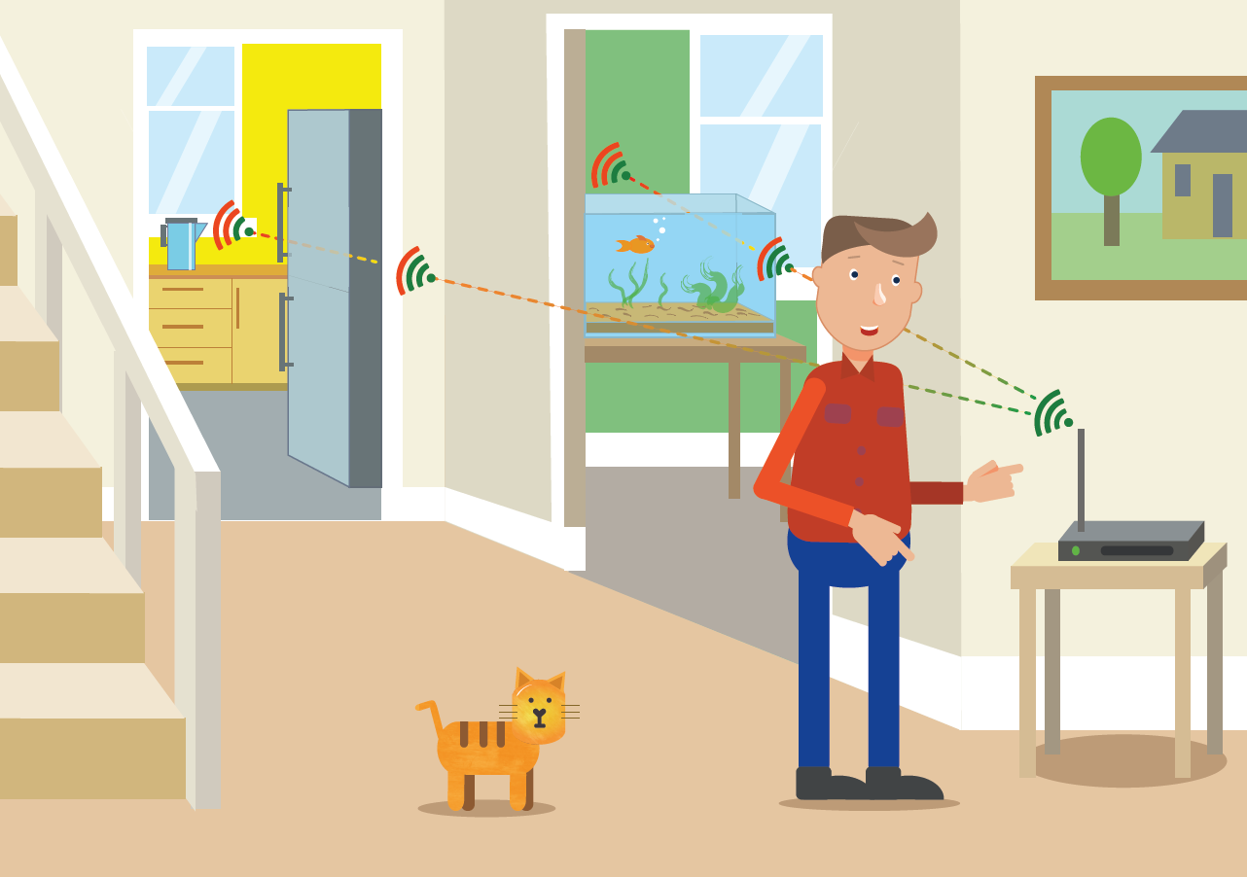
Problems with Wi-Fi
Wi-Fi signals are generally less stable, less reliable and slower than wired connections.
Wi-Fi signals are relatively short-range, so you may not get a good signal in all rooms without a Wi-Fi repeater boosting the signal.
Thick walls and electronic devices, such as fridges and microwave ovens, can interfere with a Wi-Fi signal.

Slide 8

Activity 5.1: Wired vs wireless

Slide 9
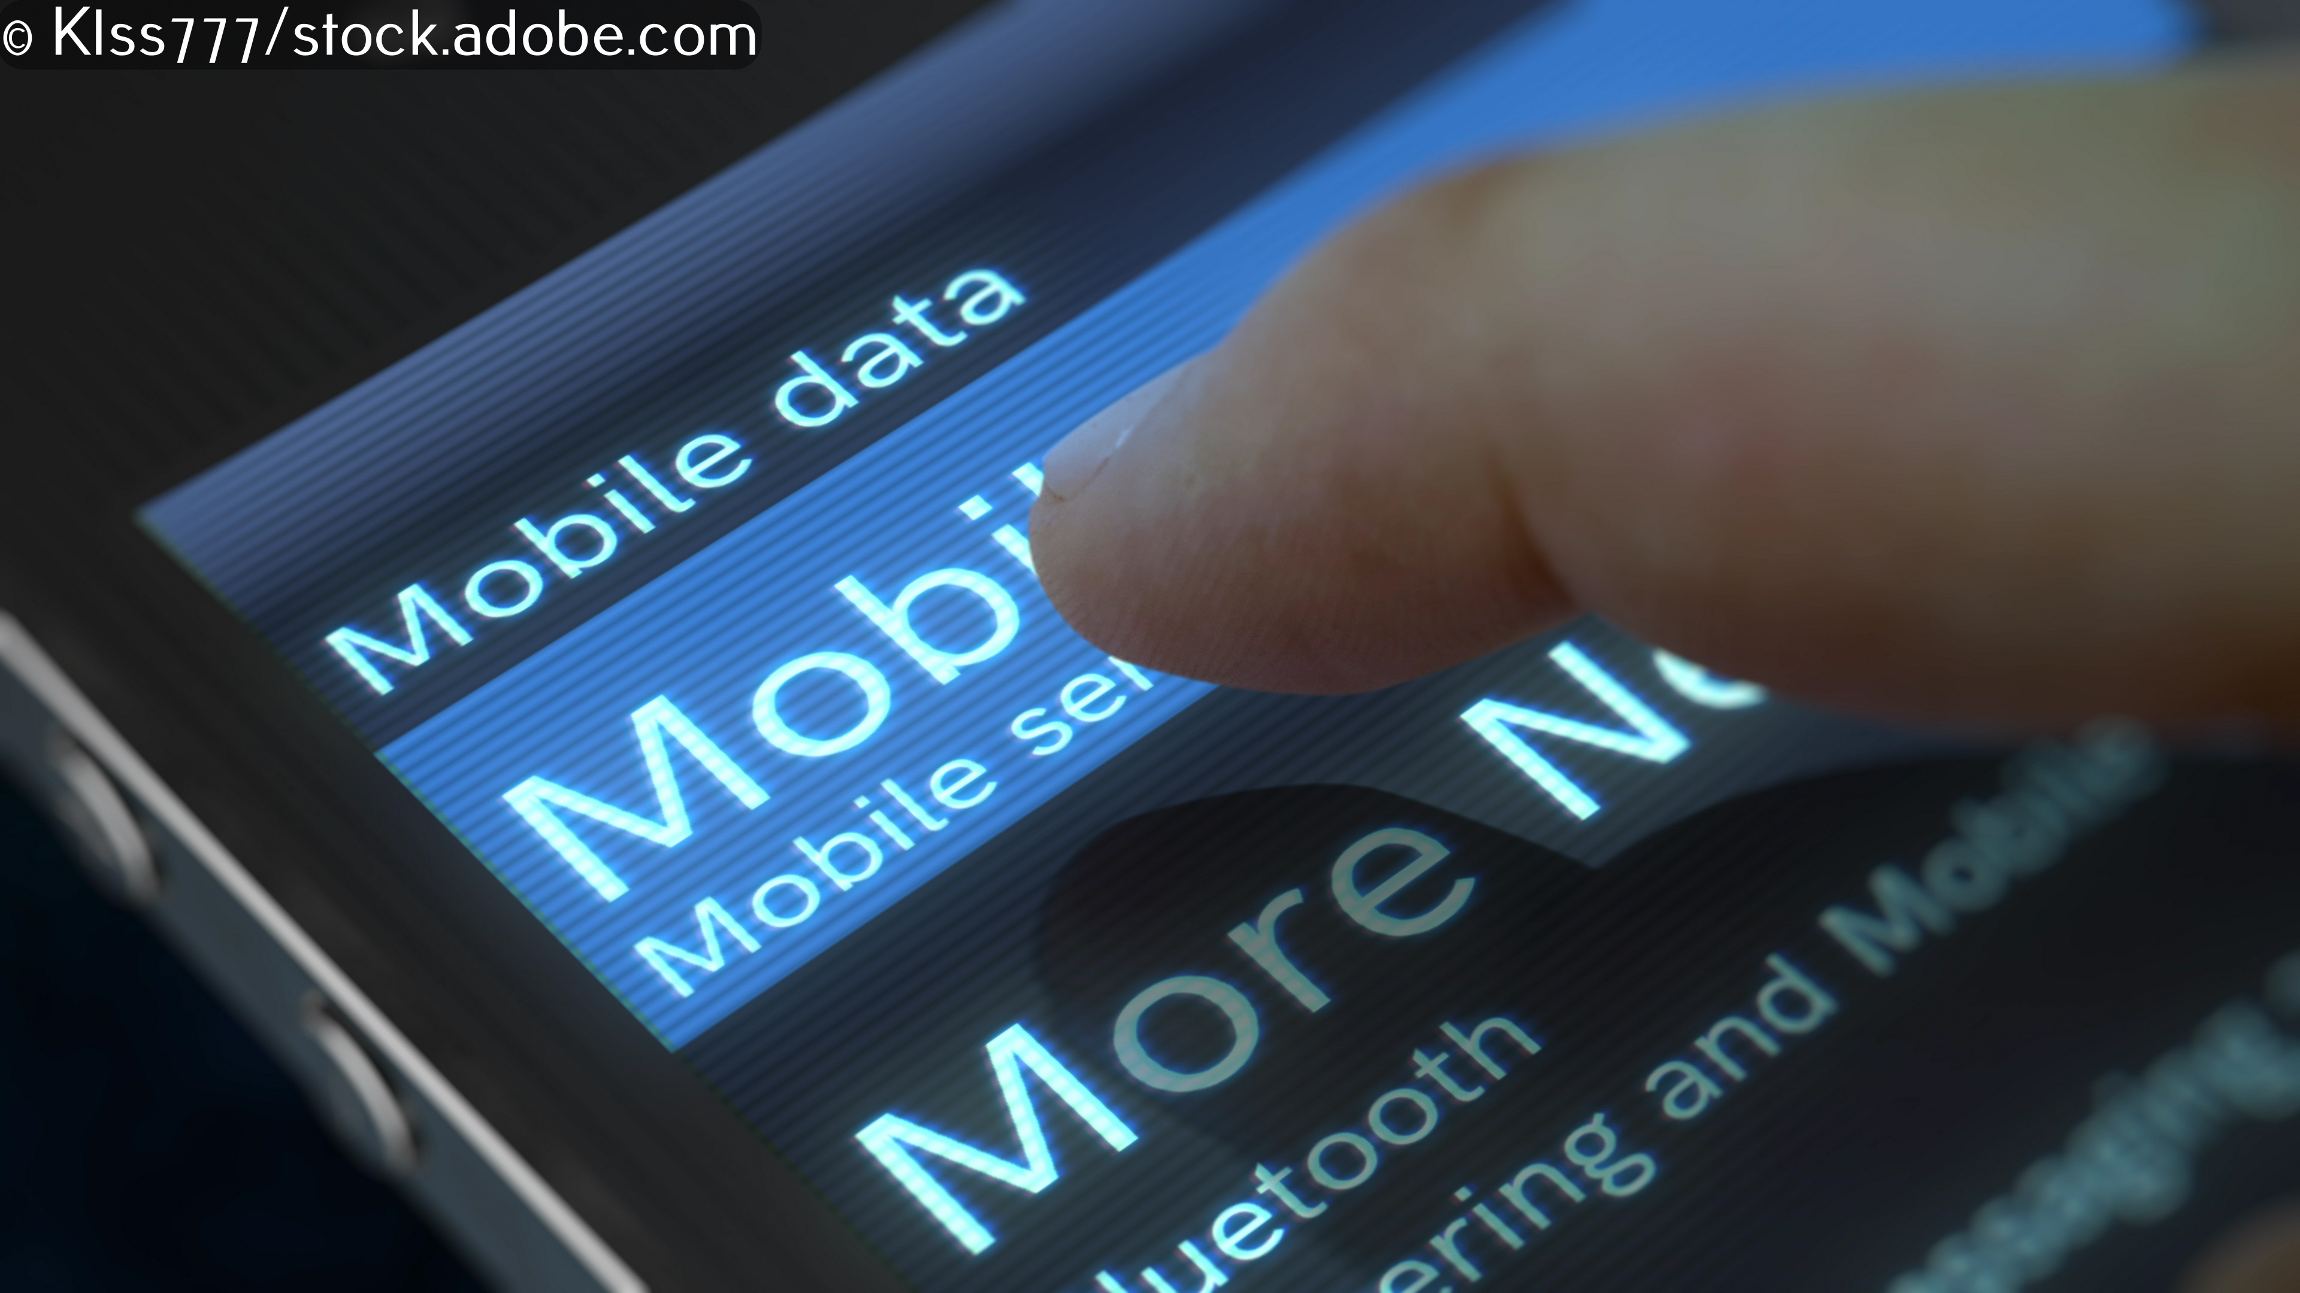
Connecting to the internet wirelessly
There are three main ways to connect to the internet wirelessly:
Private Wi-Fi
Public hotspot
Mobile data

Slide 10
Private Wi-Fi
You can usually connect to private Wi-Fi at home, work or school.
Private Wi-Fi is secure. Access to the network is password protected and the data is almost always encrypted.
Unfortunately, as soon as you leave home, work or school, you lose the connection.

Slide 11

Public hotspots
Public hotspots are found in public places like hotels, coffee shops and trains.
Everyone can access public hotspots. Access is usually free, although sometimes you must sign in by entering your details via a web page.
Connection is usually slow, although some public hotspots offer a free low-speed service and a paid-for high-speed service.
As with private Wi-Fi, as soon as you leave the hotel or coffee shop, you lose the connection.

Slide 12
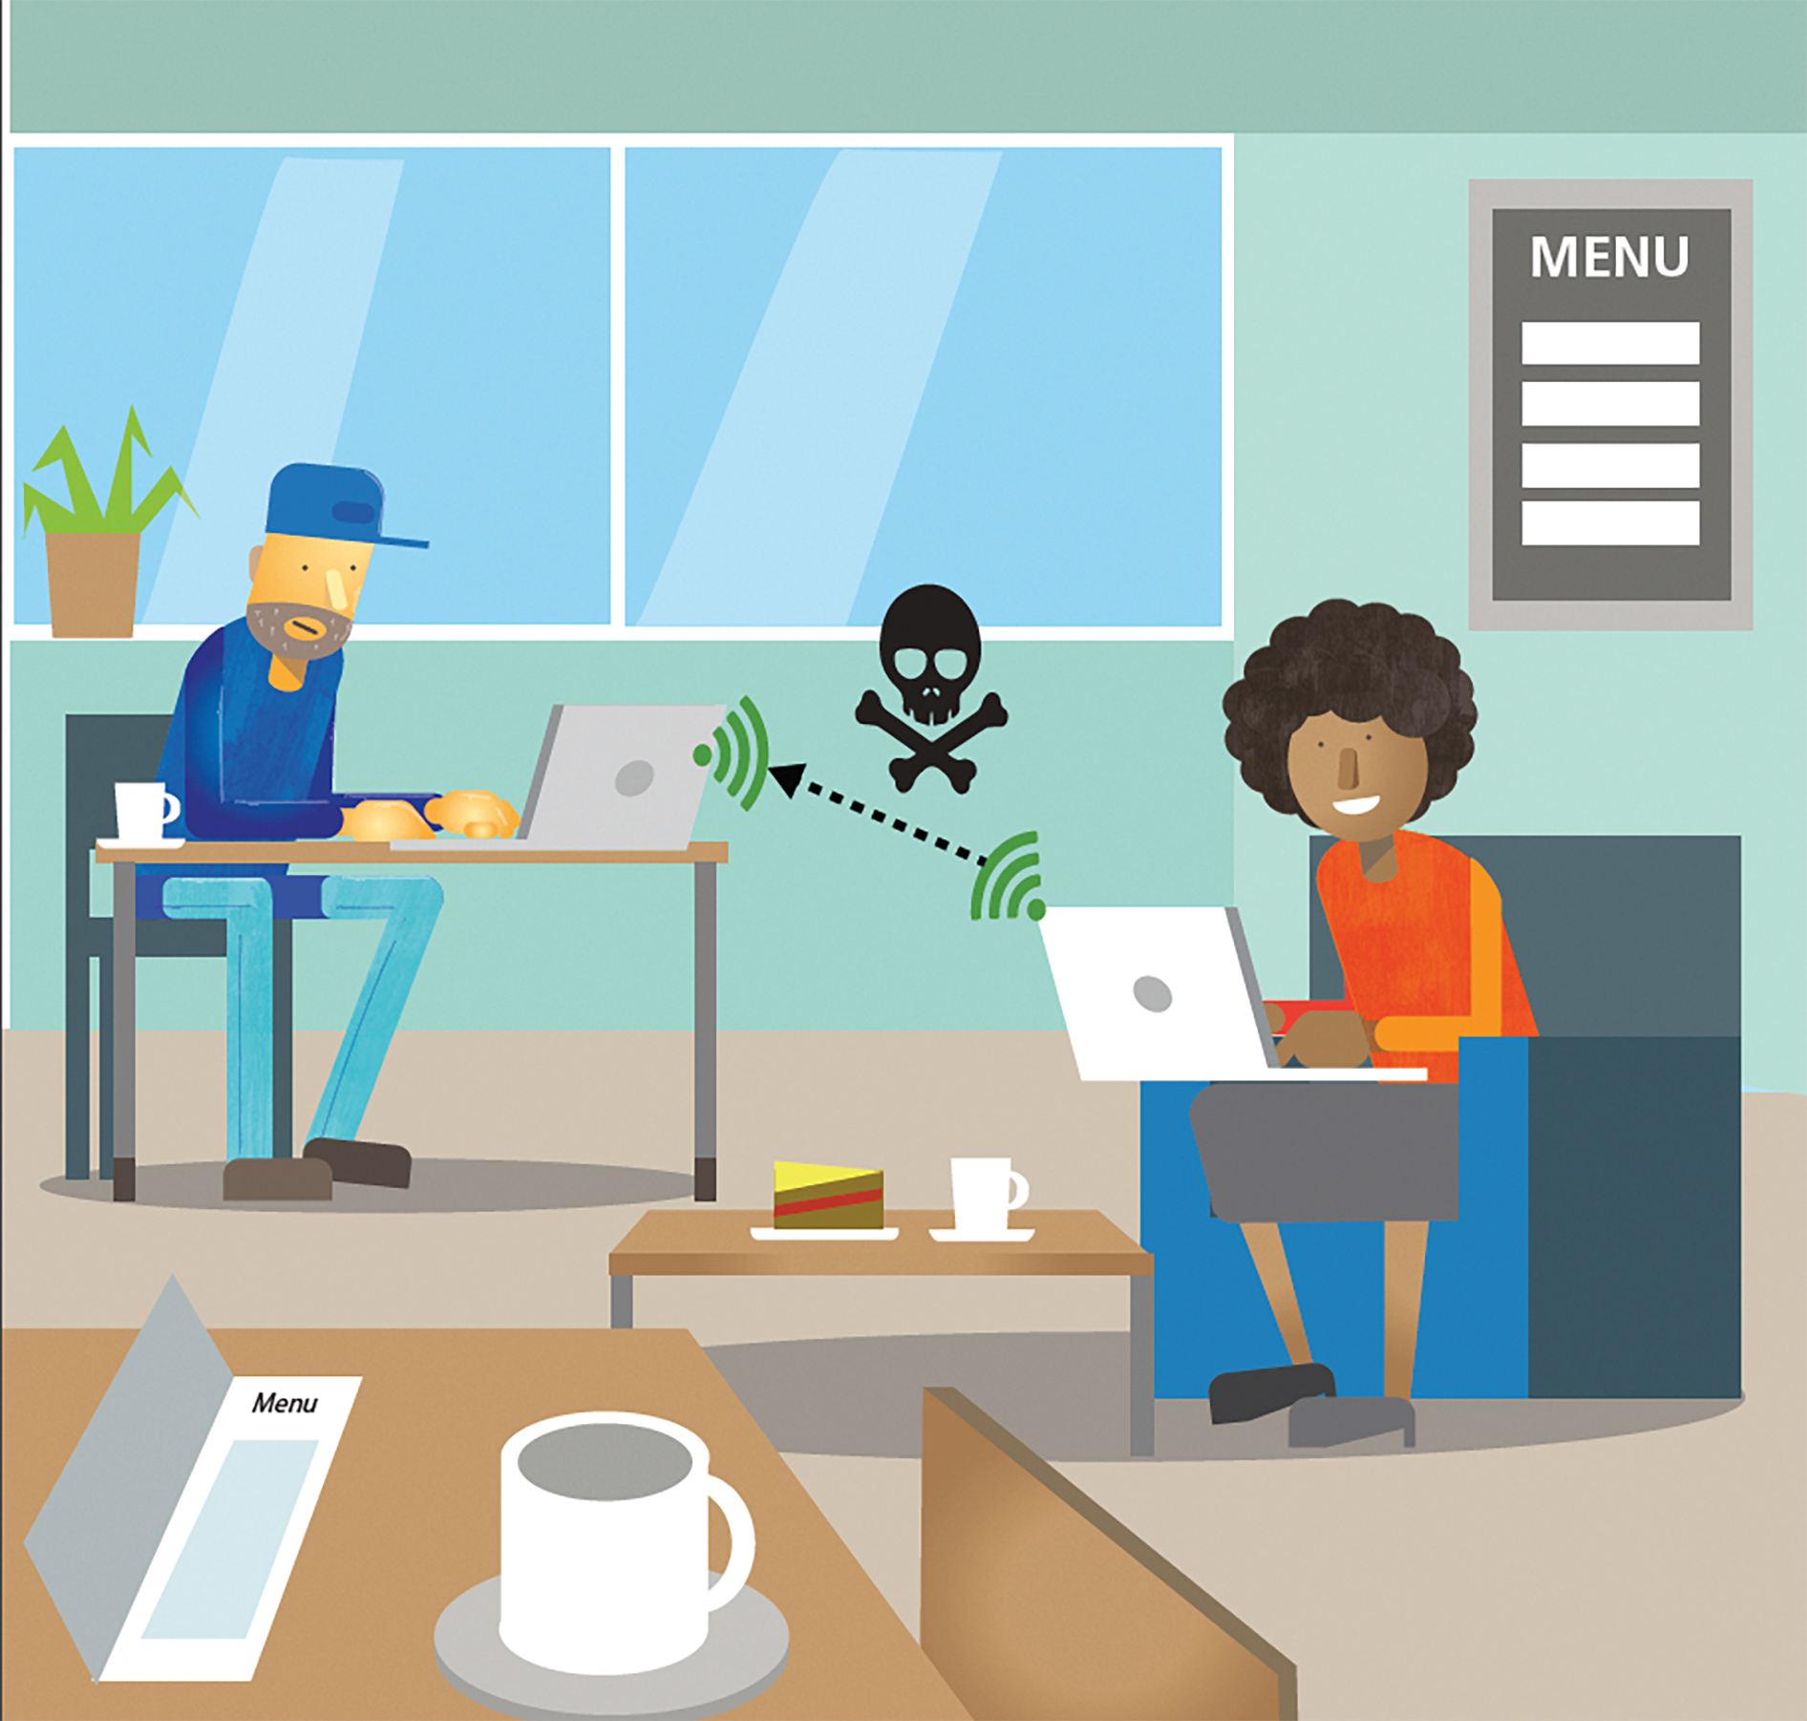
Public hotspots: DANGER!
Many public hotspots are unencrypted. Anyone nearby can intercept your data and steal your passwords!
Cyber criminals set up public hotspots, using names like ‘CoffeeShopWifi’, to entice you to connect to them and share your personal data.
If your device is set to automatically connect to a hotspot, it will connect to any hotspot with that name, regardless of whether it’s genuine or not.

Slide 13
Mobile data
Mobile data is when you use a SIM card to connect to the internet using the mobile phone network of cell towers. 2G, 3G, 4G and 5G are all types of mobile data.
Mobile data is encrypted and very secure and most people can get a good signal in most locations.
However, mobile data is expensive, especially when you use more than your contracted allowance.
Connection speeds can also slow considerably if lots of people use mobile data in a small area, at a festival or a sporting event. It can also be impossible to get a signal underground.

Slide 14
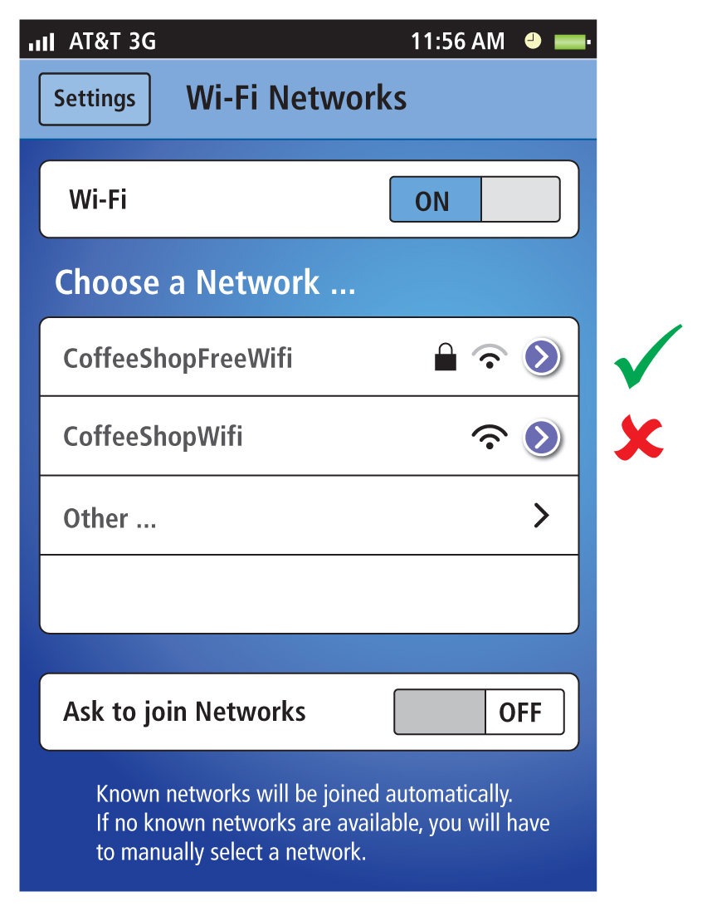
Top tips for using public hotspots safely
Look for the padlock to see if the hotspot is encrypted before deciding whether or not to use it.
Never use a public hotspot to make online purchases, do online banking or send personal information.
Never set your device to automatically connect to a public hotspot.

Slide 15
Activity 5.2: Choosing how to connect

Slide 16
Activity 5.3: Design a poster
Design a poster for your school to remind people of the key security concerns when using public hotspots.

Slide 17
Activity 5.4: Toppers (part 5)

Slide 18
Quiz 5

